Slide 1
Writing a short story
Writing Blocks

Slide 2
Blocks
Share with your seat buddy.
DO NOT THROW THEM....OFFICE.
Pre-write your short story on paper.
Keep your pre write safe.

Slide 3
Pre-write instructions
Gently roll the block.
Each side has a prompt.
Answer each prompt in point form on a piece of paper.
Keep rolling until you have answered all 6 sides.

Slide 4
Building blocks
Next group of blocks will help you build your story.
Build up your pre-write page.
Roll until all 6 sides are answered.

Slide 5
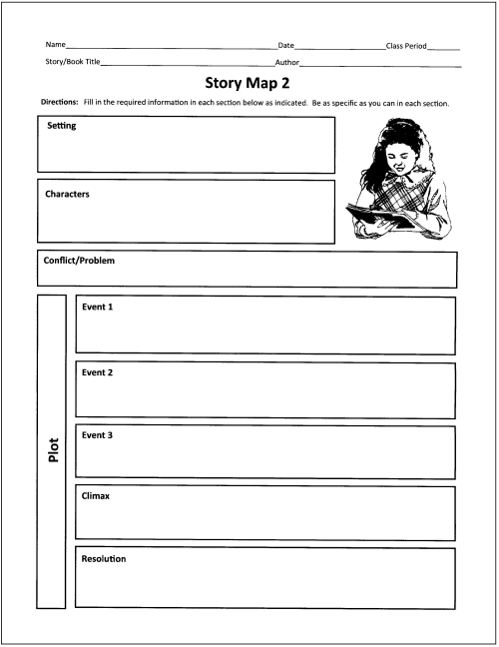
Graphic organizer

Slide 6
Check List
Yellow Blocks
Green Blocks
Graphic Organizer

Slide 7
Organizing your Story
Paragraph 1:
Exposition
Introduce setting, characters.

Slide 8
Paragraph 2
Rising action.
Introduce the problem or conflict of the story.
Build suspense.

Slide 9
Paragraph 3
Climax.
Exciting parts, conflict is going to be solved!

Slide 10
Paragraph 4
Falling action.
Bringing everything to an end.

Slide 11
Paragraph 5
Resolution.
The ending of the story.

