Slide 1
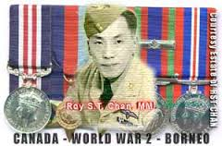
World War 2
1939-1945

Slide 2
Timeline Activity
In groups. Save your timeline sheet.
I have chosen your groups. Be good about this and you can pick next time.
Issues. Email me or speak in private.

Slide 3
Instructions
Decide dates. 5 minutes.
Type and print the date and fact.
Research:
1 picture relating to the fact.. Print.
Define underlined words. Type and print.
1 picture from the era (year) in 2 categories.
Categories:
Cars c) Weapons e) Famous Event
Clothing d) Invention

Slide 4
Instructions
On the paper organize and glue:
Typed fact..
Date
3 pictures. (Fact, 2 era).
Clean up after yourself.

Slide 5
Instructions
Get into your groups.
Organize yourselves in order of events.
Taking a piece of adhesive, create an orderly timeline!

Slide 6
Exit Slip
3 interesting facts
2 things you would like to learn more about

