Slide 1
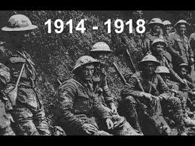
World War 1

Slide 2
Talking About War
Be respectful
Millions of people died, were tortured and starved to death: our distant cousins, great-great uncles, aunts, great grandparents
You may see images that are graphic: be respectful, these are real people, not actors or photo shop
If you are being disrespectful, you will be removed
Disrespect: laughing at people dying, or at images of starving people, making rude comments about people in war, or people who suffered because of it
There may be people in the class who have lost family members to war, think about that before you make a comment
If an image makes you uncomfortable, put your head down or ask to go to the washroom

Slide 3
Snippet: In the World
Title: WW1
Watch
Record 1 fact
10 Staggering Facts

Slide 4
In Europe...
Watch this video to help you fill out the map:
Colour AND label the 7 Continents
Put a red dot on Nova Scotia
Leave Europe white

Slide 5
WebQuest
In your gnspes email
Complete in a google doc
You may work with the person sitting next to you!! You may NOT sit where you like and work with whoever!!

