Slide 1
The 3 Hs

Slide 2
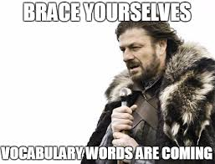
The 3 Hs of English

Slide 3
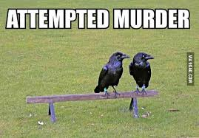
Homonyms
Same spelling
Same sound
Different meaning.

Slide 4
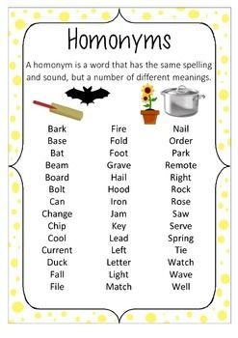
Examples
Choose 3!
Do you know the difference?

Slide 5
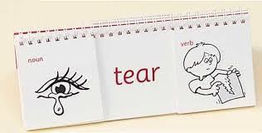
Homographs
Same spelling.
Different sound.
Different meaning.

Slide 6
Examples: Choose 3
Bow
Wind
Close
Present
Live
Read

Slide 7
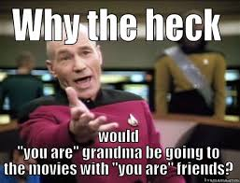
Homophones
Same sound.
Different spelling.
Different meaning.

Slide 8
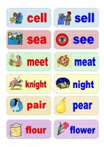
Examples
Choose 3!

Slide 9
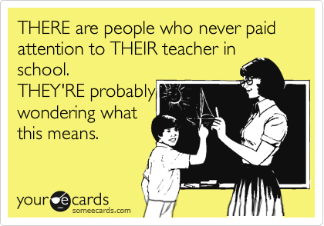
Pop Quiz: Which H?

Slide 10
Homophones!!!
There, their, they’re
Sound the same
Spelled differently
Have different meanings

Slide 11
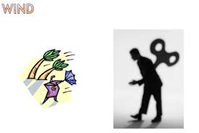

Slide 12
Homograph!!!
Same spelling
Different sound
Different meanings

Slide 14
Homonym
Same spelling
Same sound
Different meaning!!

