Slide 1
Short Story Test Review
Test: November 4

Slide 2
Elements of Short Stories
5 elements
https://www.youtube.com/watch?v=a0qq0h4xN34

Slide 3
5 Elements Definitions
Setting
Characters
Conflict
Resolution
Plot

Slide 4
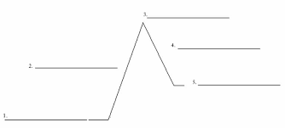
Plot Elements : Draw This
Climax
Falling Action
Rising Action
Resolution
Exposition

Slide 5
Correction
i= I
alot= a lot
Spelling
cuz= because
Your / You’re

Slide 6
Test
Definitions of elements
A story to read
Question about the story
Questions about editing: definition, importance
Questions about drafting: definition, importance
Examples to edit: paragraph, sentences

Slide 7
