Slide 1
Writing Unit: Test Review
Test: Monday October 4

Slide 2
Paragraph Writing
The 5 parts of a paragraph
Idea, topic sentence, 3 details, closing sentence, ISP
Today: Choose a topic and do a prewrite.

Slide 3
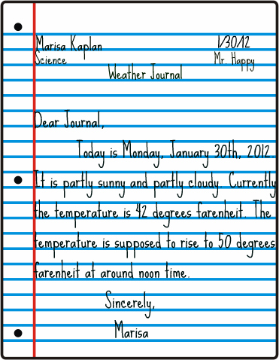
Indenting
Where is the indent?
2 finger spaces.
Start at the red line,

Slide 4
Sentence Correction
Circle the what’s wrong and fix it.
We are gonna do awesome on this tes!
___going to____test________

Slide 5
3 Hs: Definition
Homonyms: Same sound and spelling, different meaning.
Homophones: Same sound, different spelling and meaning.
Homographs: Same spelling, different sound and meaning.

Slide 6
Examples
Look in your notes and find 3 examples for EACH!
** There, their, they’re
** Your, you’re

Slide 7
Practice!!!
Today:
Pre- write your paragraph
Practice your definitions
Find 3 examples for each H
Practice there, their, they’re and your, you’re

