Slide 1
Writing a Paragraph
You’ll love it!!!

Slide 2
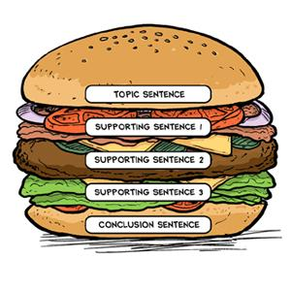
paragraph
5 parts

Slide 3
Part 1: Main idea
The main idea.
What the paragraph is about.

Slide 4
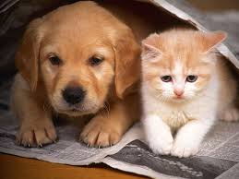
Part 2: topic sentence
1st sentence
States the main idea.
Example: Dogs
Dogs are amazing pets.
Example: Cats
Cats are awesome pets.

Slide 5
Part 3: Details
Things about the topic.
Example:
What makes a dog or a cat a good pet?
What do you like about them?
Do you have any pets?
What are their names? Colours?
Do you wish you had a pet?

Slide 6
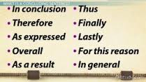
Part 4: closing sentence
Last sentence.
Ends the paragraph
Example:
That is why I think dogs are amazing pets.
Example:
Overall, cats are awesome pets.

Slide 7
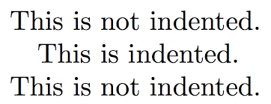
Part 5: Grammar
Indent
Spelling and punctuation check. (.,!?”)

Slide 8
Example
Writing a paragraph is easy! All you have to do is think of an idea. Write the idea down and BOOM, you have a topic sentence. Next, add 5-7 sentences or details about your topic and you’re almost done! You’ll need a closing sentence to finish your paragraph, then remember to check for indentation, correct spelling and punctuation. It’s just that easy!

Slide 9
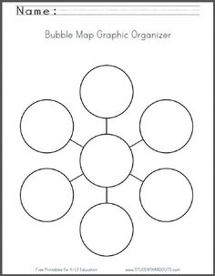
Paragraph pre write
Idea
Topic Sentence
Details: 3
Closing Sentence
ISP
Check your seat buddy!
2
3
1
Paragraph
6
4
5

Slide 10
Pre write to paragraph
Topic sentence first. Then add your details. The closing sentence to wrap it up. Remember to check your ISP. Switch with your seat buddy to edit.

