Slide 1
Superheroes
And villains!

Slide 2
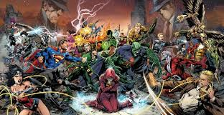
Superheroes
Go to the superhero database website
http://www.superherodb.com/index.php

Slide 3
Assignment
Follow the link.
Create a google slides called “Superheroes”.
Choose 3 Superheroes or villains.
Definition of superhero and villain.
For each hero or villain.
a) 3 Stats
b) Their real name and alias
c) 3 facts from their profile
d) 3 facts about their appearance
e) Day job
f) Picture

Slide 4
Example
https://docs.google.com/presentation/d/191dJe-_9BdZVsle1WfWBpGfwLS0O-LezxvV-2ZX3ioI/edit#slide=id.p

