Slide 1
Snippet: In the world
Title: Pollution
How can we stop pollution?

Slide 2
Short stories
Elements

Slide 3
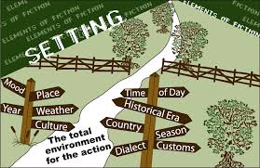
setting
Where and when a story takes place.

Slide 4
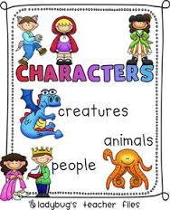
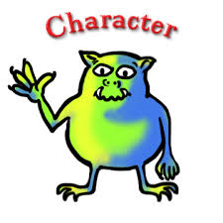
Characters
People or animals in the story.
Change during the story.

Slide 5
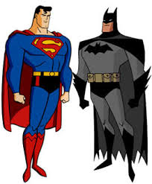
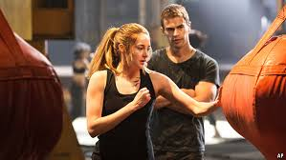
Types of Characters
Protagonist: The Hero

Slide 6
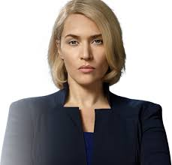
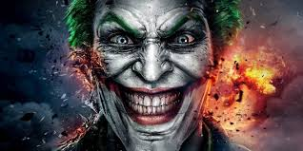
Villain
Bad guys.

Slide 7
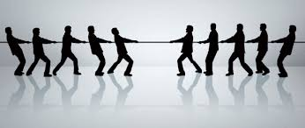
Conflict
The problem

Slide 8
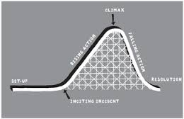
Plot
The events of the story.

Slide 9
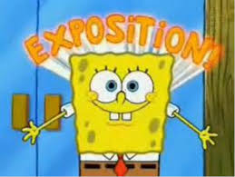
Plot...
Exposition: Beginning. Where the conflict is.

Slide 10
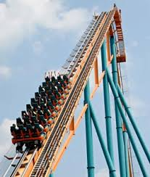
Rising Action
Builds suspense.
Conflict or problem.

Slide 11
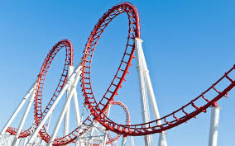
Climax
Exciting part.
Most important.
Reveal.

Slide 12
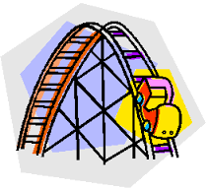
Falling Action
Things calm down.
Ending is coming.

Slide 13
Resolution
Problem solved!

Slide 14
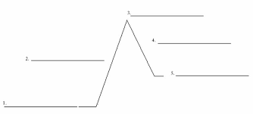
Practice
Draw a plot map on your paper.

Slide 15
Write this next to it….
Exposition.
Rising action.
Climax
Falling.
Resolution

Slide 16
Watch and fill in your paper
https://www.youtube.com/watch?v=u6g_5aThEv0

Slide 17
“For the birds”
Setting: Phone line
Characters: Little birds, big bird
Conflict: They didn’t like big bird, he wanted to be their friend.

Slide 18
Plot
Exposition: Little birds are hanging out, trying to ignore the big bird.
Rising Action: Big bird sits with them and bends the line. They bite him.
Climax: Big bird falls, little birds go flying.
Falling action: Little birds land with no feathers.
Resolution: Big bird laughs, gets little birds back for being mean.

