Slide 1
Opinion Letter
Formal

Slide 2
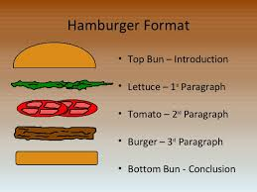
The Format

Slide 3
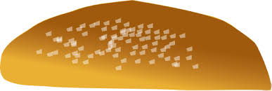
Introduction
Paragraph 1
Thesis: I think...because
Briefly introduce the 3 points you will make.
Example:
I think teens are addicted to cell phones because they are always on them. Statistics show there are more accidents related to cell phone use and driving than ever before. Accidents are also happening on the street as teens are walking into traffic and into Halifax Harbour while looking at their phones.

Slide 4
Detail 1
Paragraph 2
The first detail of your introduction.
Discuss it in more depth.
Example:
Teens are always on their phones. They use them constantly in class and stay up to late hours of the night watching videos and posting on social media. Teens never go anywhere without their phones and even experience phantom vibrations (itches on the body mistaken for a phone vibration). Teens today even sleep with their phones as they use them for alarm clocks. The phone is the first and last thing they see before bed and after waking up!

Slide 5
Detail 2
Paragraph 3
The 2nd detail in the introduction.
Discuss in depth.
Example:
Teens are involved in cell phone related accidents every day. Accidents involving vehicles are the most dangerous. Teens are texting and posting on social media when they are driving. This is very dangerous and can result in physical harm, disfigurement or even death.

Slide 6
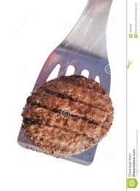
Detail 3
Paragraph 4
The 3rd detail in your introduction.
Discuss it more in depth.
Example:
Teens are involved in cell phone related accidents every day. These accidents range from vehicular damage, even death to walking into man made objects. Pokemon Go has led teens to walk off cliffs, into traffic and into Halifax Harbour. Teens are so focused on their phones they forget to watch where they are going. This can have disastrous effects on the well being of teens.

Slide 7
Conclusion
Paragraph 5
Restate your thesis and supporting details.
Brief.
A suggestion for improvement or changing the problem.
Example:
It is clear that some teens are addicted to their phones. You never see a teen without their phone in hand and it can become very dangerous when they stop paying attention to their surroundings when walking or driving. Teens can stay safe by paying attention to the world around them.

Slide 8
Project: Opinion Letter
https://docs.google.com/document/d/1JzbTHgj22knEl-0N6Xdub4p4sR7GKSfje3REdTvjgCo/edit

