Slide 1
Creating a Comic
Comic Strips

Slide 2
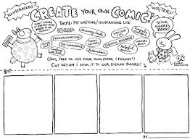
Comic Story
Create a comic strip for your hero.
Graphic Organizer: Beginning, middle, end
Draft and Edit***
1) Graphic Organizer
2) RC on back
3) Edit RC

Slide 3
Comic Maker
USE YOUR GRAPHIC ORGANIZER
8 blocks minimum
Print & colour

